Slide 1
Unit-1

Slide 2
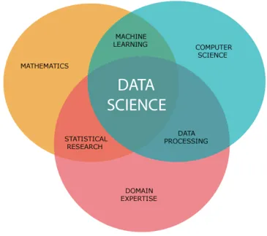
What is Data Science?
It is a multidisciplinary field that involves the use of statistical and computational methods to extract insights and knowledge from data. To analyze and comprehend large data sets, it uses techniques from computer science, mathematics, and statistics.
Data mining, machine learning, and data visualization are just a few of the tools and methods we frequently employ to draw meaning from data. They may deal with both structured and unstructured data, including text and pictures, databases, and spreadsheets.

Slide 3
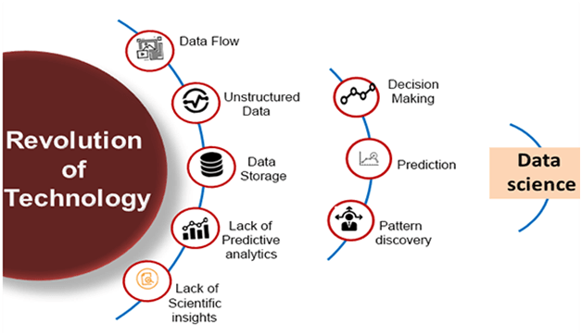
Data Science is about data gathering, analysis and decision-making.
Data Science is about finding patterns in data, through analysis, and make future predictions.
By using Data Science, companies are able to make:
Better decisions (should we choose A or B)
Predictive analysis (what will happen next?)
Pattern discoveries (find pattern, or maybe hidden information in the data)

Slide 4
Applications:
Banking
Consultancy
Healthcare
Manufacturing
Climate research
Economics
etc
It is about finding patterns in data, through analysis, and make future predictions.
By using Data Science, are able to make:
Better decisions (should we choose A or B)
Predictive analysis (what will happen next?)
Pattern discoveries (find pattern, or maybe hidden information in the data)

Slide 5
Facets of data:
1.Structured
2.Semi structured
3. Unstructured
• Natural language
• Machine-generated
• Graph-based
• Audio, video, and images
• Streaming
1.Structured Data:
It concerns all data which can be stored in database SQL in table with rows and columns.
They have relational key and can be easily mapped into pre-designed fields.
Today, those data are the most processed in development and the simplest way to manage information.
But structured data represent only 5 to 10% of all informatics data.

Slide 6
2.Semi Structured Data:
Semi-structured data is information that doesn’t reside in a relational database but that does have some organizational properties that make it easier to analyze.
In some process store them in relation database (it could be very hard for some kind of semi structured data), but the semi structure exists to ease space, clarity or compute…
But as Structured data, semi structured data represents a few parts of data (5 to 10%).
Examples of semi-structured: JSON, CSV , XML documents are semi structured documents.
3.Unstructured data:
Unstructured data represent around 80% of data.
It often include text and multimedia content.
Examples include e-mail messages, word processing documents, videos, photos, audio files, presentations, webpages and many other kinds of business documents.
4.Unstructured data is everywhere.
In fact, most individuals and organizations conduct their lives around unstructured data.
Just as with structured data, unstructured data is either machine generated or human generated.

Slide 7
Machine-generated unstructured data:
Satellite images: This includes weather data or the data that the government captures in its satellite surveillance imagery. Just think about Google Earth, and you get the picture.
Photographs and video: This include security, surveillance, and traffic video.
Radar or sonar data: This includes vehicular, meteorological, and Seismic oceanography.
The following list shows a few examples of human-generated unstructured data:
Social media data: This data is generated from the social media platforms such as YouTube, Facebook, Twitter, LinkedIn, and Flickr.
Mobile data: This includes data such as text messages and location information.
website content: This comes from any site delivering unstructured content, like YouTube, Flickr, or Instagram.

Slide 8
Human-generated unstructured data:
Social media data: This data is generated from the social media platforms such as YouTube, Facebook, Twitter, LinkedIn, and Flickr.
Mobile data: This includes data such as text messages and location information.
website content: This comes from any site delivering unstructured content, like YouTube, Flickr, or Instagram.
i)Natural Language:
Natural language is a special type of unstructured data; it’s challenging to process because it requires knowledge of specific data science techniques and linguistics.
The natural language processing community has had success in entity recognition, topic recognition, summarization, and sentiment analysis, but models trained in one domain don’t generalize well to other domains.
ii)Graph based or Network Data:
In graph theory, a graph is a mathematical structure to model pair-wise relationships between objects.
Graph or network data is, in short, data that focuses on the relationship or adjacency of objects.
The graph structures use nodes, edges, and properties to represent and store graphical data. Graph-based data is a natural way to represent social networks.

Slide 9
iii)Audio, Image & Video:
Audio, image, and video are data types that pose specific challenges to a data scientist.
MLBAM (Major League Baseball Advanced Media) announced in 2014 that they’ll increase video capture to approximately 7 TB per game for the purpose of live, in-game analytics. High-speed cameras at stadiums will capture ball and athlete movements to calculate in real time, for example, the path taken by a defender relative to two baselines.
iv)Streaming Data:
Streaming data is data that is generated continuously by thousands of data sources, which typically send in the data records simultaneously, and in small sizes (order of Kilobytes).
Examples are the-Log files generated by customers using your mobile or web applications, online game activity, “What’s trending” on Twitter, live sporting or music events, and the stock market.

Slide 10
Introduction to Numpy
Data science is an evolutionary extension of statistics capable of dealing with the massive amounts of data that are regularly produced today. It adds methods from computer science to the repertoire of statistics.
Data scientists who need to work with data for analysis, modeling, or forecasting should become familiar with NumPy’s usage and its capabilities, as it will help them quickly prototype and test their ideas.
NumPy, short for Numerical Python, provides an efficient interface for storing and manipulating extensive data in the Python programming language. NumPy supplies functions you can call, which makes it especially useful for data manipulations. Later in this article, we will look into the methods and operations we can perform in NumPy.
Benefits that NumPy
More speed: NumPy uses algorithms written in C that complete in nanoseconds rather than seconds.
Fewer loops: NumPy helps you to reduce loops and keep from getting tangled up in iteration indices.
Clearer code: Without loops, your code will look more like the equations you’re trying to calculate.
Better quality: There are thousands of contributors working to keep NumPy fast, friendly, and bug free.

Slide 11
NumPy is an open-source python library for processing n-dimensional arrays created by Travis Oliphant in 2005.
It stands for “Numerical Python” and provides tools for mathematical operations and linear algebra.
Combines the flexibility of Python with the speed of optimized C code.
Its easy-to-use syntax makes it accessible for programmers of all levels.

Slide 12
NumPy array in Python
Python lists are a substitute for arrays, but they fail to deliver the performance required while computing large sets of numerical data.
To address this issue we use a python library called NumPy. The word NumPy stands for Numerical Python. NumPy offers an array object called ndarray. They are similar to standard python sequences but differ in certain key factors.
NumPy arrays vs inbuilt Python sequences
Unlike lists, NumPy arrays are of fixed size, and changing the size of an array will lead to the creation of a new array while the original array will be deleted.
All the elements in an array are of the same type.
Numpy arrays are faster, more efficient, and require less syntax than standard python sequences.
Numpy arrays are written mostly in C language. Being written in C, the NumPy arrays are stored in contiguous memory locations which makes them accessible and easier to manipulate.

Slide 13
First, install NumPy and can import it in your program
import numpy as np
np is a commonly used alias to NumPy.
ndarray of a list using the array() method
li = [1,2,3,4]
numpyArr = np.array(li)
Or
numpyArr = np.array([1,2,3,4])
import numpy as np
li = [1, 2, 3, 4]
numpyArr = np.array(li)
print(numpyArr)

Slide 14
import numpy as np
li = [1, 2, 3, 4]
numpyArr = np.array(li)
print("li =", li, "and type(li) =", type(li))
print("numpyArr =", numpyArr, "and type(numpyArr) =", type(numpyArr))
Output:
li = [1, 2, 3, 4] and type(li) = <class 'list'>
numpyArr = [1 2 3 4] and type(numpyArr) = <class 'numpy.ndarray'>

Slide 15
NumPy array from a tuple
tup = (1,2,3,4)
numpyArr = np.array(tup)
import numpy as np
tup = (1, 2, 3, 4)
numpyArr = np.array(tup)
print("tup =", tup, "and type(tup) =", type(tup))
print("numpyArr =", numpyArr, "and type(numpyArr) =", type(numpyArr))
Output:
tup = (1, 2, 3, 4) and type(tup) = <class 'tuple'>
numpyArr = [1 2 3 4] and type(numpyArr) = <class 'numpy.ndarray'>

Slide 16
import numpy as np
# Creating a rank 1 Array
arr = np.array([1, 2, 3])
print("Array with Rank 1: \n",arr)
# Creating a rank 2 Array
arr = np.array([[1, 2, 3],
[4, 5, 6]])
print("Array with Rank 2: \n", arr)
# Creating an array from tuple
arr = np.array((1, 3, 2))
print("\nArray created using “ "passed tuple:\n", arr)
Output:
Array with Rank 1:
[1 2 3]
Array with Rank 2:
[[1 2 3]
[4 5 6]]
Array created using passed tuple:
[1 3 2]

Slide 17
Access Array Elements
Array indexing is the same as accessing an array element.
You can access an array element by referring to its index number.
The indexes in NumPy arrays start with 0, meaning that the first element has index 0, and the second has index 1 etc.
import numpy as np
arr = np.array([1, 2, 3, 4])
print(arr[0])
import numpy as np
arr = np.array([1, 2, 3, 4])
print(arr[1])
import numpy as np
arr = np.array([1, 2, 3, 4])
print(arr[2] + arr[3])

Slide 18
Access 2-D Arrays
To access elements from 2-D arrays we can use comma separated integers representing the dimension and the index of the element.
Think of 2-D arrays like a table with rows and columns, where the dimension represents the row and the index represents the column.
import numpy as np
arr = np.array([[1,2,3,4,5], [6,7,8,9,10]])
print('2nd element on 1st row: ', arr[0, 1])
import numpy as np
arr = np.array([[1,2,3,4,5], [6,7,8,9,10]])
print('5th element on 2nd row: ', arr[1, 4])

Slide 19
Example Explained
arr[0, 1, 2] prints the value 6.
And this is why:
The first number represents the first dimension, which contains two arrays:
[[1, 2, 3], [4, 5, 6]]
and:
[[7, 8, 9], [10, 11, 12]]
Since we selected 0, we are left with the first array:
[[1, 2, 3], [4, 5, 6]]
The second number represents the second dimension, which also contains two arrays:
[1, 2, 3]
and:
[4, 5, 6]
Since we selected 1, we are left with the second array:
[4, 5, 6]
The third number represents the third dimension, which contains three values:
4
5
6
Since we selected 2, we end up with the third value:
6
Access 3-D Arrays
To access elements from 3-D arrays we can use comma separated integers representing the dimensions and the index of the element.
import numpy as np
arr = np.array([[[1, 2, 3], [4, 5, 6]], [[7, 8, 9], [10, 11, 12]]])
print(arr[0, 1, 2])

Slide 20
Negative Indexing
Use negative indexing to access an array from the end.
Example
Print the last element from the 2nd dim:
import numpy as np
arr = np.array([[1,2,3,4,5], [6,7,8,9,10]])
print('Last element from 2nd dim: ', arr[1, -1])
import numpy as np
arr = np.array([[1,2,3,4,5], [6,7,8,9,10]])
print('Last element from 2nd dim: ', arr[1, -1])

Slide 21
NumPy Array Slicing
Slicing in python means taking elements from one given index to another given index.
We pass slice instead of index like this: [start:end].
We can also define the step, like this: [start:end:step].
If we don't pass start its considered 0
If we don't pass end its considered length of array in that dimension
If we don't pass step its considered 1
Example
Slice elements from index 1 to index 5 from the following array:
import numpy as np
arr = np.array([1, 2, 3, 4, 5, 6, 7])
print(arr[1:5])

Slide 22
Example
Slice elements from index 4 to the end of the array:
import numpy as np
arr = np.array([1, 2, 3, 4, 5, 6, 7])
print(arr[4:])
import numpy as np
arr = np.array([1, 2, 3, 4, 5, 6, 7])
print(arr[:4])

Slide 23
Negative Slicing
Use the minus operator to refer to an index from the end:
import numpy as np
arr = np.array([1, 2, 3, 4, 5, 6, 7])
print(arr[-3:-1])
Output:
[5 6]
STEP
Use the step value to determine the step of the slicing:
import numpy as np
arr = np.array([1, 2, 3, 4, 5, 6, 7])
print(arr[1:5:2])
Output:
[2 4]

Slide 24
Return every other element from the entire array:
import numpy as np
arr = np.array([1, 2, 3, 4, 5, 6, 7])
print(arr[::2])
Output:
[1 3 5 7]
Slicing 2-D Arrays
From the second element, slice elements from index 1 to index 4 (not included):
import numpy as np
arr = np.array([[1, 2, 3, 4, 5], [6, 7, 8, 9, 10]])
print(arr[0, 1:4])
Output:
[2 3 4]

Slide 25
From both elements, return index 2:
import numpy as np
arr = np.array([[1, 2, 3, 4, 5], [6, 7, 8, 9, 10]])
print(arr[0:2, 2])
From both elements, slice index 1 to index 4 (not included), this will return a 2-D array:

Slide 26
import numpy as np
a = np.array([[1,2,3],[3,4,5],[4,5,6]])
print 'Our array is:'
print a
print '\n'
# this returns array of items in the second column
print 'The items in the second column are:'
print a[...,1]
print '\n'
# Now we will slice all items from the second row
print 'The items in the second row are:'
print a[1,...]
print '\n'
# Now we will slice all items from column 1 onwards
print 'The items column 1 onwards are:'
print a[...,1:]
Output:
Our array is:
[[1 2 3]
[3 4 5]
[4 5 6]]
The items in the second column are:
[2 4 5]
The items in the second row are:
[3 4 5]
The items column 1 onwards are:
[[2 3]
[4 5]
[5 6]]

Slide 27
Reshaping arrays
Reshaping means changing the shape of an array.
The shape of an array is the number of elements in each dimension.
By reshaping we can add or remove dimensions or change number of elements in each dimension.
Syntax : array.reshape(shape)
Reshape From 1-D to 2-D
import numpy as np
arr = np.array([1, 2, 3, 4, 5, 6, 7, 8, 9, 10, 11, 12])
newarr = arr.reshape(4, 3)
print(newarr)
Output:
[[ 1 2 3]
[ 4 5 6]
[ 7 8 9]
[10 11 12]]

Slide 28
import numpy as np
# creating a numpy array
array = np.array([1, 2, 3, 4, 5, 6, 7, 8, 9, 10, 11, 12, 13, 14, 15, 16])
# printing array
print("Array : " + str(array))
# length of array
n = array.size
# N-D array N dimension
N = 4
# calculating M
M = n//N
# reshaping numpy array
# converting it to 2-D from 1-D array
reshaped1 = array.reshape((N, M))
# printing reshaped array
print("First Reshaped Array : ")
print(reshaped1)
# creating another reshaped array
reshaped2 = np.reshape(array, (2, 8))
# printing reshaped array
print("Second Reshaped Array : ")
print(reshaped2)

Slide 29
Reshaping N-D to 1-D array
In this example we will see how we can reshape a 2-D or 3-D array to form a 1-D array. We can also use reshape(-1) to do this, here -1 is the unknown dimension.
import numpy as np
# creating a numpy array
array = np.array([[1, 2, 3],
[4, 5, 6],
[7, 8, 9]])
# printing array
print(" 2-D Array : ")
print(array)
# reshaping numpy array
# converting it to 1-D from 2-D array
reshaped = array.reshape((9))
# or we can use unknown dimension
# reshaped = array.reshape((-1))
# printing reshaped array
print("Reshaped 1-D Array : ")
print(reshaped)
Output:
2-D Array :
[[1 2 3]
[4 5 6]
[7 8 9]]
Reshaped 1-D Array :
[[1 2 3 4 5 6 7 8 9]]

Slide 30
Joining NumPy Arrays
Joining means putting contents of two or more arrays in a single array.
In SQL we join tables based on a key, whereas in NumPy we join arrays by axes.
We pass a sequence of arrays that we want to join to the concatenate() function, along with the axis. If axis is not explicitly passed, it is taken as 0.
import numpy as np
arr1 = np.array([1, 2, 3])
arr2 = np.array([4, 5, 6])
arr = np.concatenate((arr1, arr2))
print(arr)
Output:
[1 2 3 4 5 6]

Slide 31
Example
Join two 2-D arrays along rows (axis=1):
import numpy as np
arr1 = np.array([[1, 2], [3, 4]])
arr2 = np.array([[5, 6], [7, 8]])
arr = np.concatenate((arr1, arr2), axis=1)
print(arr)
Output:
[[1 2 5 6]
[3 4 7 8]]

Slide 32
Joining Arrays Using Stack Functions
Stacking is same as concatenation, the only difference is that stacking is done along a new axis.
We can concatenate two 1-D arrays along the second axis which would result in putting them one over the other, ie. stacking.
We pass a sequence of arrays that we want to join to the stack() method along with the axis. If axis is not explicitly passed it is taken as 0.
import numpy as np
arr1 = np.array([1, 2, 3])
arr2 = np.array([4, 5, 6])
arr = np.stack((arr1, arr2), axis=1)
print(arr)

Slide 33
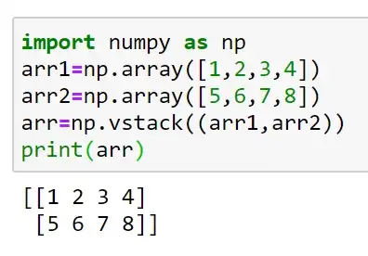
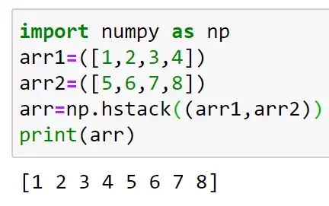
Stack are of three types:
Horizontal stacking
Vertical stacking
Height stacking
Horizontal stacking : Horizontal stacking is done along the rows.
Vertical stacking:
Vertical stacking is done along the columns.

Slide 34
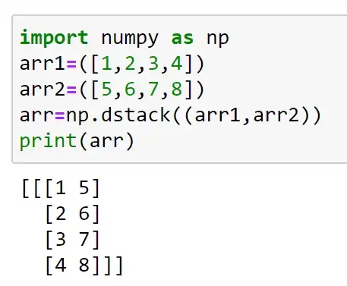
Height stacking:
Height stacking is used to stack along the height.

Slide 35
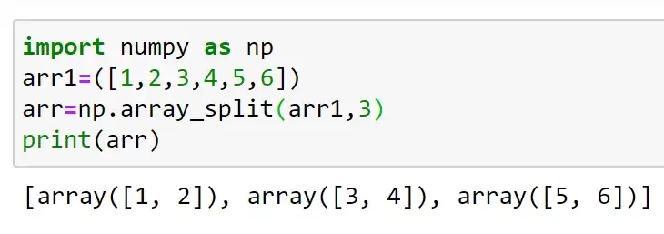
Numpy split:
Split function is the opposite of join operation.
Join combines multiple arrays into one whereas splitting breaks one array into multiple arrays.
We use array_stack() for splitting array.

Slide 36
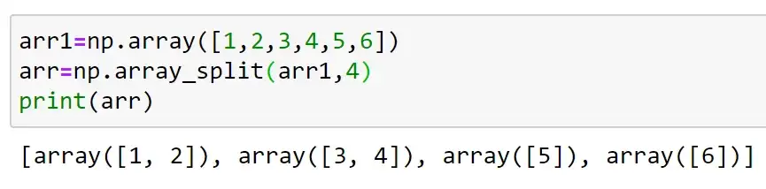
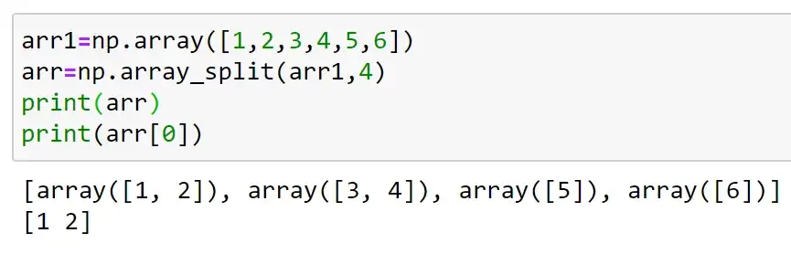
If the array has less elements than required it will adjust from the end accordingly.
There is another method to do splitting; which is done using split() which is similar to array_split().
But when the elements are lesser than the required, split() does not adjust and it will throw errors.
To access splitted array;

Slide 37
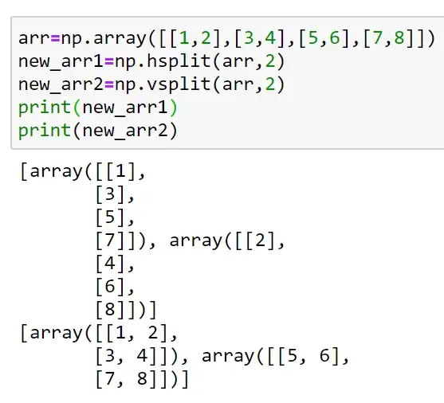
Similarly we can do for 2-D arrays. There are hsplit(), vsplit() and dsplit().
dsplit only works on arrays of 3 or more dimensions.

Slide 38
Data Structures in Pandas
Pandas is an open-source library that uses for working with relational or labeled data both easily and intuitively.
It provides various data structures and operations for manipulating numerical data and time series.
It offers a tool for cleaning and processes your data.
It is the most popular Python library that is used for data analysis.
It supports two data structures:
Series
Dataframe

Slide 39
Series
Pandas is a one-dimensional labeled array and capable of holding data of any type (integer, string, float, python objects, etc.)
Syntax: pandas.Series(data=None, index=None, dtype=None, name=None, copy=False, fastpath=False)
data: array- Contains data stored in Series.
index: array-like or Index (1d)
dtype: str, numpy.dtype, or ExtensionDtype, optional
name: str, optional
copy: bool, default False

Slide 40
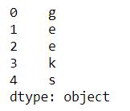
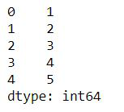
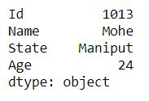
Series holding the char data type.
import pandas as pd
# a simple char list
list = ['g', 'e', 'e', 'k', 's']
# create series form a char list
res = pd.Series(list)
print(res)
import pandas as pd
# a simple int list
list = [1,2,3,4,5]
# create series form a int list
res = pd.Series(list)
print(res)
import pandas as pd
dic = { 'Id': 1013, 'Name': 'MOhe', 'State': 'Maniput','Age': 24}
res = pd.Series(dic)
print(res)

Slide 41
Dataframe
Pandas DataFrame is a two-dimensional size-mutable, potentially heterogeneous tabular data structure with labeled axes (rows and columns).
A Data frame is a two-dimensional data structure, i.e., data is aligned in a tabular fashion in rows and columns like a spreadsheet or SQL table, or a dict of Series objects.
Pandas DataFrame consists of three principal components, the data, rows, and columns.
Creating a Pandas DataFrame
In the real world, a Pandas DataFrame will be created by loading the datasets from existing storage, storage can be SQL Database, CSV file, and Excel file.
Pandas DataFrame can be created from the lists, dictionary, and from a list of dictionary etc.
Dataframe can be created in different ways here are some ways by which we create a dataframe:

Slide 42
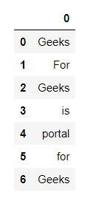
DataFrame can be created using a single list o a list of lists.
A Dataframe is a two-dimensional data structure, i.e., data is aligned in a tabular fashion in rows and columns.
In dataframe datasets arrange in rows and columns, we can store any number of datasets in a dataframe. We can perform many operations on these datasets like arithmetic operation, columns/rows selection, columns/rows addition etc.
# import pandas as pd
import pandas as pd
# list of strings
lst = ['Geeks', 'For', 'Geeks', 'is', 'portal', 'for', 'Geeks']
# Calling DataFrame constructor on list
df = pd.DataFrame(lst)
display(df)

Slide 43
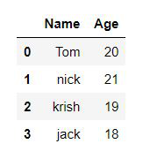
Creating DataFrame from dict of ndarray/lists.
To create DataFrame from dict of narray/list, all the narray must be of same length.
If index is passed then the length index should be equal to the length of arrays.
If no index is passed, then by default, index will be range(n) where n is the array length.
import pandas as pd
# initialise data of lists.
data = {'Name':['Tom', 'nick', 'krish', 'jack'],
'Age':[20, 21, 19, 18]}
# Create DataFrame
df = pd.DataFrame(data)
# Print the output.
display(df)

Slide 44
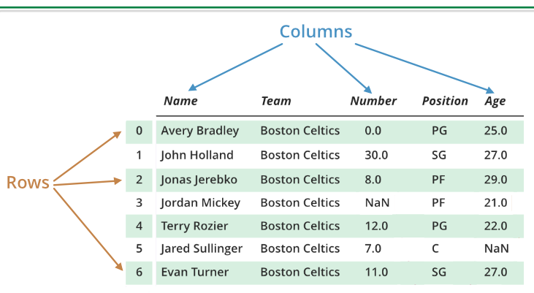
Dealing with Rows and Columns in Pandas DataFrame
A Data frame is a two-dimensional data structure, i.e., data is aligned in a tabular fashion in rows and columns.
We can perform basic operations on rows/columns like selecting, deleting, adding, and renaming. In this article, we are using nba.csv file.
Dealing with Columns
In order to deal with columns, we perform basic operations on columns like selecting, deleting, adding and renaming.

Slide 45
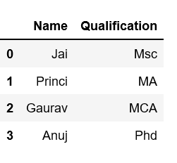
Column Selection:
In Order to select a column in Pandas DataFrame, we can either access the columns by calling them by their columns name.
import pandas as pd
# Define a dictionary containing employee data
data = {'Name':['Jai', 'Princi', 'Gaurav', 'Anuj'],
'Age':[27, 24, 22, 32],
'Address':['Delhi', 'Kanpur', 'Allahabad', 'Kannauj'],
'Qualification':['Msc', 'MA', 'MCA', 'Phd']}
# Convert the dictionary into DataFrame
df = pd.DataFrame(data)
# select two columns
print(df[['Name', 'Qualification']])

Slide 46
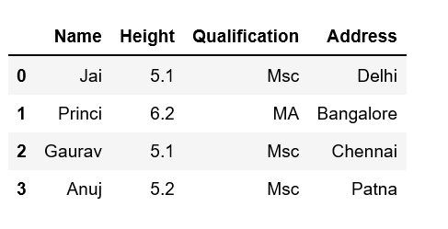
Add a column in Pandas DataFrame
import pandas as pd
# Define a dictionary containing Students data
data = {'Name': ['Jai', 'Princi', 'Gaurav', 'Anuj'],
'Height': [5.1, 6.2, 5.1, 5.2],
'Qualification': ['Msc', 'MA', 'Msc', 'Msc']}
# Convert the dictionary into DataFrame
df = pd.DataFrame(data)
# Declare a list that is to be converted into a column
address = ['Delhi', 'Bangalore', 'Chennai', 'Patna']
# Using 'Address' as the column name
# and equating it to the list
df['Address'] = address
# Observe the result
print(df)

Slide 47
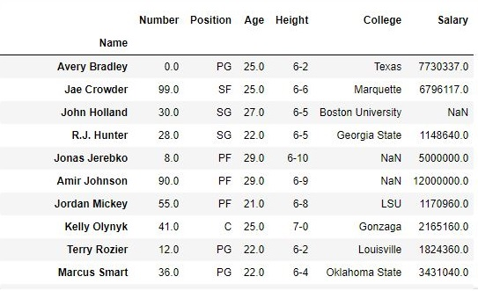
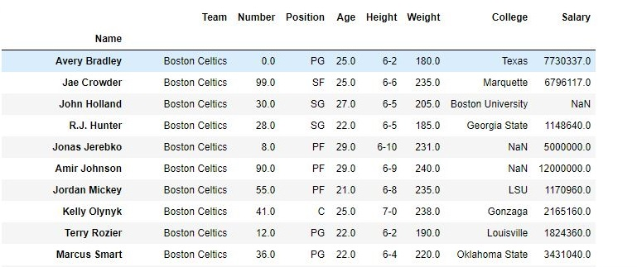
Column Deletion:
import pandas as pd
# making data frame from csv file
data = pd.read_csv("nba.csv", index_col ="Name" )
# dropping passed columns
data.drop(["Team", "Weight"], axis = 1, inplace = True)
# display
print(data)
Data Frame after Dropping Columns-
Data Frame before Dropping Columns

Slide 48
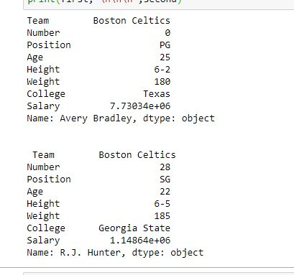
Dealing with Rows:
In order to deal with rows, we can perform basic operations on rows like selecting, deleting, adding and renaming.
Row Selection:
Pandas provide a unique method to retrieve rows from a Data frame.DataFrame.loc[] method is used to retrieve rows from Pandas DataFrame. Rows can also be selected by passing integer location to an iloc[] function.
import pandas as pd
# making data frame from csv file
data = pd.read_csv("nba.csv", index_col ="Name")
# retrieving row by loc method
first = data.loc["Avery Bradley"]
second = data.loc["R.J. Hunter"]
print(first, "\n\n\n", second)

Slide 49
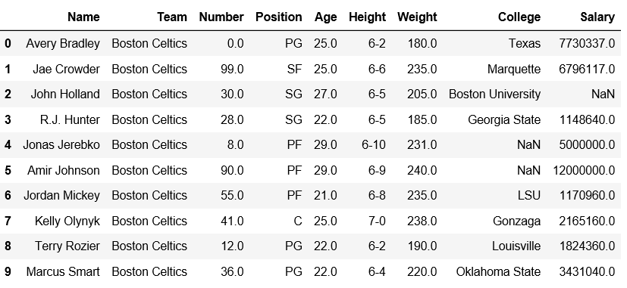
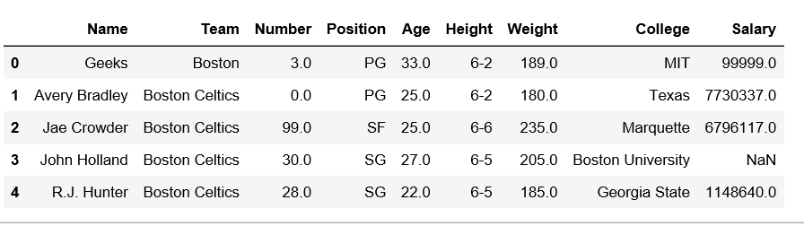
Row Addition:
In Order to add a Row in Pandas DataFrame, we can concat the old dataframe with new one.
import pandas as pd
# making data frame
df = pd.read_csv("nba.csv", index_col ="Name")
df.head(10)
new_row = pd.DataFrame({'Name':'Geeks', 'Team':'Boston', 'Number':3,
'Position':'PG', 'Age':33, 'Height':'6-2',
'Weight':189, 'College':'MIT', 'Salary':99999},
index =[0])
# simply concatenate both dataframes
df = pd.concat([new_row, df]).reset_index(drop = True)
df.head(5)
Data Frame before Adding Row-
Data Frame after Adding Row-

Slide 50
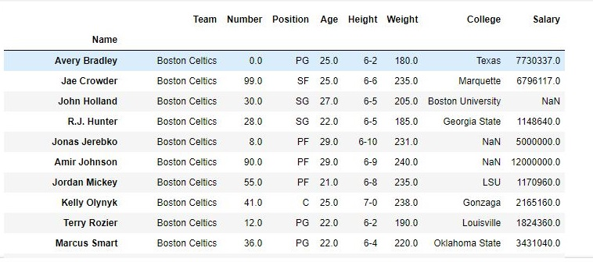
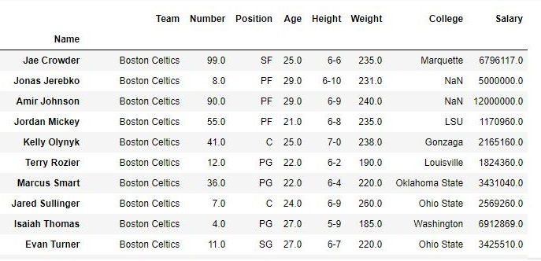
Row Deletion:
In Order to delete a row in Pandas DataFrame, we can use the drop() method. Rows is deleted by dropping Rows by index label.
Data Frame before Dropping values-
import pandas as pd
# making data frame from csv file
data = pd.read_csv("nba.csv", index_col ="Name" )
# dropping passed values
data.drop(["Avery Bradley", "John Holland", "R.J. Hunter",
"R.J. Hunter"], inplace = True)
# display
data
Data Frame after Dropping values-

Slide 51
Pandas Index
Pandas Index is defined as a vital tool that selects particular rows and columns of data from a DataFrame. Its task is to organize the data and to provide fast accessing of data. It can also be called a Subset Selection.
The values are in bold font in the index, and the individual value of the index is called a label.
If we want to compare the data accessing time with and without indexing, we can use %%timeit for comparing the time required for various access-operations.
We can also define an index like an address through which any data can be accessed across the Series or DataFrame. A DataFrame is a combination of three different components, the index, columns, and the data.

Slide 52
Axis and axes
An axis is defined as a common terminology that refers to rows and columns, whereas axes are collection of these rows and columns.
Creating index
First, we have to take a csv file that consist some data used for indexing.
# importing pandas package
import pandas as pd
data = pd.read_csv("aa.csv")
data
Name Hire Date Salary Leaves Remaining
0 John Idle 03/15/14 50000.0 10
1 Smith Gilliam 06/01/15 65000.0 8
2 Parker Chapman 05/12/14 45000.0 10
3 Jones Palin 11/01/13 70000.0 3
4 Terry Gilliam 08/12/14 48000.0 7
5 Michael Palin 05/23/13 66000.0 8

Slide 53
# importing pandas package
import pandas as pd
# making data frame from csv file
info = pd.read_csv("aa.csv", index_col ="Name")
# retrieving multiple columns by indexing operator
a = info[["Hire Date", "Salary"]]
print(a)
Name Hire Date Salary
0 John Idle 03/15/14 50000.0
1 Smith Gilliam 06/01/15 65000.0
2 Parker Chapman 05/12/14 45000.0
3 Jones Palin 11/01/13 70000.0
4 Terry Gilliam 08/12/14 48000.0
5 Michael Palin 05/23/13 66000.0

Slide 54
# importing pandas package
Import pandas as pd
# making data frame from csv file
info =pd.read_csv("aa.csv", index_col ="Name")
# retrieving columns by indexing operator
a =info["Salary"]
print(a)
Name Salary
0 John Idle 50000.0
1 Smith Gilliam 65000.0
2 Parker Chapman 45000.0
3 Jones Palin 70000.0
4 Terry Gilliam 48000.0
5 Michael Palin 66000.0

Slide 55
Set index
The 'set_index' is used to set the DataFrame index using existing columns. An index can replace the existing index and can also expand the existing index.
It set a list, Series or DataFrame as the index of the DataFrame.
info = pd.DataFrame({'Name': ['Parker', 'Terry', 'Smith', 'William'],
'Year': [2011, 2009, 2014, 2010],
'Leaves': [10, 15, 9, 4]})
info
info.set_index('Name')
info.set_index(['year', 'Name'])
info.set_index([pd.Index([1, 2, 3, 4]), 'year'])
a = pd.Series([1, 2, 3, 4])
info.set_index([a, a**2])
Name Year Leaves
1 1 Parker 2011 10
2 4 Terry 2009 15
3 9 Smith 2014 9
4 16 William 2010 4

Slide 56
Basic Functionality
Sr.No. | Attribute or Method & Description
1 | axes Returns a list of the row axis labels
2 | dtype Returns the dtype of the object.
3 | empty Returns True if series is empty.
4 | ndim Returns the number of dimensions of the underlying data, by definition 1.
5 | size Returns the number of elements in the underlying data.
6 | values Returns the Series as ndarray.
7 | head() Returns the first n rows.
8 | tail() Returns the last n rows.

Slide 57
import pandas as pd
import numpy as np
#Create a series with 100 random numbers
s = pd.Series(np.random.randn(4))
print s
0 -0.210459
1 0.919947
2 -0.546783
3 -1.032091
dtype: float64
import pandas as pd
import numpy as np
#Create a series with 100 random numbers
s = pd.Series(np.random.randn(4))
print ("The axes are:")
print s.axes
The axes are:
[RangeIndex(start=0, stop=4, step=1)]

Slide 58
import pandas as pd
import numpy as np
#Create a series with 100 random numbers
s = pd.Series(np.random.randn(4))
print ("Is the Object empty?")
print s.empty
Is the Object empty?
False
import pandas as pd
import numpy as np
#Create a series with 4 random numbers
s = pd.Series(np.random.randn(4))
print s
print ("The dimensions of the object:")
print s.ndim
0 0.175898
1 0.166197
2 -0.609712
3 -1.377000
dtype: float64
The dimensions of the object:
1

Slide 59
import pandas as pd
import numpy as np
#Create a series with 4 random numbers
s = pd.Series(np.random.randn(2))
print s
print ("The size of the object:")
print s.size
0 3.078058
1 -1.207803
dtype: float64
The size of the object:
2
Head & Tail
To view a small sample of a Series or the DataFrame object, use the head() and the tail() methods.
head() returns the first n rows(observe the index values). The default number of elements to display is five, but you may pass a custom number.
The original series is:
0 0.720876
1 -0.765898
2 0.479221
3 -0.139547
dtype: float64
The first two rows of the data series:
0 0.720876
1 -0.765898
dtype: float64
import pandas as pd
import numpy as np
#Create a series with 4 random numbers
s = pd.Series(np.random.randn(4))
print ("The original series is:")
print s
print ("The first two rows of the data series:")
print s.head(2)

Slide 60
tail() returns the last n rows(observe the index values). The default number of elements to display is five, but you may pass a custom number.
The original series is:
0 -0.655091
1 -0.881407
2 -0.608592
3 -2.341413
dtype: float64
The last two rows of the data series:
2 -0.608592
3 -2.341413
dtype: float64
import pandas as pd
import numpy as np
#Create a series with 4 random numbers
s = pd.Series(np.random.randn(4))
print ("The original series is:")
print s
print ("The last two rows of the data series:")
print s.tail(2)

Slide 61
T (Transpose)
Returns the transpose of the DataFrame. The rows and columns will interchange.
import pandas as pd
import numpy as np
# Create a Dictionary of series
d = {'Name':pd.Series(['Tom','James','Ricky','Vin','Steve','Smith','Jack']),
'Age':pd.Series([25,26,25,23,30,29,23]),
'Rating':pd.Series([4.23,3.24,3.98,2.56,3.20,4.6,3.8])}
# Create a DataFrame
df = pd.DataFrame(d)
print ("The transpose of the data series is:")
print df.T
The transpose of the data series is:
0 1 2 3 4 5 6
Age 25 26 25 23 30 29 23
Name Tom James Ricky Vin Steve Smith Jack
Rating 4.23 3.24 3.98 2.56 3.2 4.6 3.8

Slide 62
Python Pandas - Descriptive Statistics
A large number of methods collectively compute descriptive statistics and other related operations on DataFrame.
Most of these are aggregations like sum(), mean(), but some of them, like sumsum(), produce an object of the same size. Generally speaking, these methods take an axis argument, just like ndarray.{sum, std, ...}, but the axis can be specified by name or integer
DataFrame − “index” (axis=0, default), “columns” (axis=1)
Create a DataFrame and use this object
import pandas as pd
import numpy as np
#Create a Dictionary of series
d = {'Name':pd.Series(['Tom','James','Ricky','Vin','Steve','Smith','Jack',
'Lee','David','Gasper','Betina','Andres']),
'Age':pd.Series([25,26,25,23,30,29,23,34,40,30,51,46]),
'Rating':pd.Series([4.23,3.24,3.98,2.56,3.20,4.6,3.8,3.78,2.98,4.80,4.10,3.65])
}
#Create a DataFrame
df = pd.DataFrame(d)
print df
Age Name Rating
0 25 Tom 4.23
1 26 James 3.24
2 25 Ricky 3.98
3 23 Vin 2.56
4 30 Steve 3.20
5 29 Smith 4.60
6 23 Jack 3.80
7 34 Lee 3.78
8 40 David 2.98
9 30 Gasper 4.80
10 51 Betina 4.10
11 46 Andres 3.65

Slide 63
sum()
Returns the sum of the values for the requested axis. By default, axis is index (axis=0).
import pandas as pd
import numpy as np
#Create a Dictionary of series
d = {'Name':pd.Series(['Tom','James','Ricky','Vin','Steve','Smith','Jack',
'Lee','David','Gasper','Betina','Andres']),
'Age':pd.Series([25,26,25,23,30,29,23,34,40,30,51,46]),
'Rating':pd.Series([4.23,3.24,3.98,2.56,3.20,4.6,3.8,3.78,2.98,4.80,4.10,3.65])
}
#Create a DataFrame
df = pd.DataFrame(d)
print df.sum()
Age 382
Name TomJamesRickyVinSteveSmithJackLeeDavidGasperBe...
Rating 44.92
dtype: object

Slide 64
import pandas as pd
import numpy as np
#Create a Dictionary of series
d = {'Name':pd.Series(['Tom','James','Ricky','Vin','Steve','Smith','Jack',
'Lee','David','Gasper','Betina','Andres']),
'Age':pd.Series([25,26,25,23,30,29,23,34,40,30,51,46]),
'Rating':pd.Series([4.23,3.24,3.98,2.56,3.20,4.6,3.8,3.78,2.98,4.80,4.10,3.65])
}
#Create a DataFrame
df = pd.DataFrame(d)
print df.sum(1)
0 29.23
1 29.24
2 28.98
3 25.56
4 33.20
5 33.60
6 26.80
7 37.78
8 42.98
9 34.80
10 55.10
11 49.65
dtype: float64

Slide 65
mean()
Returns the average value
import pandas as pd
import numpy as np
#Create a Dictionary of series
d = {'Name':pd.Series(['Tom','James','Ricky','Vin','Steve','Smith','Jack',
'Lee','David','Gasper','Betina','Andres']),
'Age':pd.Series([25,26,25,23,30,29,23,34,40,30,51,46]),
'Rating':pd.Series([4.23,3.24,3.98,2.56,3.20,4.6,3.8,3.78,2.98,4.80,4.10,3.65])
}
#Create a DataFrame
df = pd.DataFrame(d)
print df.mean()
Age 31.833333
Rating 3.743333
dtype: float64

Slide 66
std()
Returns the Bressel standard deviation of the numerical columns.
import pandas as pd
import numpy as np
#Create a Dictionary of series
d = {'Name':pd.Series(['Tom','James','Ricky','Vin','Steve','Smith','Jack',
'Lee','David','Gasper','Betina','Andres']),
'Age':pd.Series([25,26,25,23,30,29,23,34,40,30,51,46]),
'Rating':pd.Series([4.23,3.24,3.98,2.56,3.20,4.6,3.8,3.78,2.98,4.80,4.10,3.65])
}
#Create a DataFrame
df = pd.DataFrame(d)
print df.std()
Age 9.232682
Rating 0.661628
dtype: float64

Slide 67
Functions & Description
Understand the functions under Descriptive Statistics in Python Pandas. The following table list down the important functions −
Sr.No. | Function | Description
1 | count() | Number of non-null observations
2 | sum() | Sum of values
3 | mean() | Mean of Values
4 | median() | Median of Values
5 | mode() | Mode of values
6 | std() | Standard Deviation of the Values
7 | min() | Minimum Value
8 | max() | Maximum Value
9 | abs() | Absolute Value
10 | prod() | Product of Values
11 | cumsum() | Cumulative Sum
12 | cumprod() | Cumulative Product

Slide 68
Functions like sum(), cumsum() work with both numeric and character (or) string data elements without any error. Though n practice, character aggregations are never used generally, these functions do not throw any exception.
Functions like abs(), cumprod() throw exception when the DataFrame contains character or string data because such operations cannot be performed.
Summarizing Data
The describe() function computes a summary of statistics pertaining to the DataFrame columns.
import pandas as pd
import numpy as np
#Create a Dictionary of series
d = {'Name':pd.Series(['Tom','James','Ricky','Vin','Steve','Smith','Jack',
'Lee','David','Gasper','Betina','Andres']),
'Age':pd.Series([25,26,25,23,30,29,23,34,40,30,51,46]),
'Rating':pd.Series([4.23,3.24,3.98,2.56,3.20,4.6,3.8,3.78,2.98,4.80,4.10,3.65])
}
#Create a DataFrame
df = pd.DataFrame(d)
print df.describe()
Age Rating
count 12.000000 12.000000
mean 31.833333 3.743333
std 9.232682 0.661628
min 23.000000 2.560000
25% 25.000000 3.230000
50% 29.500000 3.790000
75% 35.500000 4.132500
max 51.000000 4.800000

Slide 69
object − Summarizes String columns
number − Summarizes Numeric columns
all − Summarizes all columns together (Should not pass it as a list value)
import pandas as pd
import numpy as np
#Create a Dictionary of series
d = {'Name':pd.Series(['Tom','James','Ricky','Vin','Steve','Smith','Jack',
'Lee','David','Gasper','Betina','Andres']),
'Age':pd.Series([25,26,25,23,30,29,23,34,40,30,51,46]),
'Rating':pd.Series([4.23,3.24,3.98,2.56,3.20,4.6,3.8,3.78,2.98,4.80,4.10,3.65])
}
#Create a DataFrame
df = pd.DataFrame(d)
print df.describe(include=['object'])
Name
count 12
unique 12
top Tom
freq 1

Slide 70
import pandas as pd
import numpy as np
#Create a Dictionary of series
d = {'Name':pd.Series(['Tom','James','Ricky','Vin','Steve','Smith','Jack',
'Lee','David','Gasper','Betina','Andres']),
'Age':pd.Series([25,26,25,23,30,29,23,34,40,30,51,46]),
'Rating':pd.Series([4.23,3.24,3.98,2.56,3.20,4.6,3.8,3.78,2.98,4.80,4.10,3.65])
}
#Create a DataFrame
df = pd.DataFrame(d)
print df. describe(include='all')
Age Name Rating
count 12.000000 12 12.000000
unique NaN 12 NaN
top NaN Ricky NaN
freq NaN 1 NaN
mean 31.833333 NaN 3.743333
std 9.232682 NaN 0.661628
min 23.000000 NaN 2.560000
25% 25.000000 NaN 3.230000
50% 29.500000 NaN 3.790000
75% 35.500000 NaN 4.132500
max 51.000000 NaN 4.800000

Slide 71
Data loading
Read CSV Files
A simple way to store big data sets is to use CSV files (comma separated files).
CSV files contains plain text and is a well know format that can be read by everyone including Pandas.
In our examples we will be using a CSV file called 'data.csv'.
import pandas as pd
df = pd.read_csv('data.csv')
print(df.to_string())
import pandas as pd
df = pd.read_csv('data.csv')
print(df)
max_rows
The number of rows returned is defined in Pandas option settings.
You can check your system's maximum rows with the pd.options.display.max_rows statement.
import pandas as pd
print(pd.options.display.max_rows)

Slide 72
File formats
pandas read_csv() and .to_csv()
Python can work with the following file formats:
Comma-separated values (CSV)
XLSX
ZIP
Plain Text (txt)
JSON
XML
HTML
Image
Hierarchical Data Format
PDF
DOCX
MP3
MP4
SQL
import pandas as pd
You can save your pandas DataFrame as a CSV file with .to_csv():
df.to_csv('data.csv')
Read a CSV File
Once your data is saved in a CSV file, you’ll likely want to load and use it from time to time. You can do that with the pandas read_csv() function:
df = pd.read_csv('data.csv', index_col=0)
Write an Excel File
Once you have those packages installed, you can save your DataFrame in an Excel file with .to_excel():
df.to_excel('data.xlsx')
Read an Excel File
You can load data from Excel files with read_excel():
df = pd.read_excel('data.xlsx', index_col=0)

Slide 73
data=pandas.read_csv(‘filename.txt’, sep=’ ‘, header=None, names=[“Column1”, “Column2”])
filename.txt: As the name suggests it is the name of the text file from which we want to read data.
sep: It is a separator field. In the text file, we use the space character(‘ ‘) as the separator.
header: This is an optional field. By default, it will take the first line of the text file as a header. If we use header=None then it will create the header.
names: We can assign column names while importing the text file by using the names argument.

Slide 74
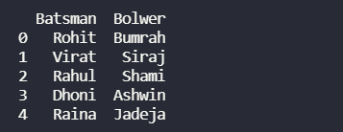
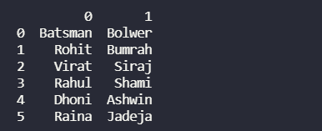
import pandas as pd
# read text file into pandas DataFrame
df = pd.read_csv("gfg.txt", sep=" ")
# display DataFrame
print(df)
import pandas as pd
# read text file into pandas DataFrame and
# create header
df = pd.read_csv("gfg.txt", sep=" ", header=None)
# display DataFrame
print(df)

Slide 75
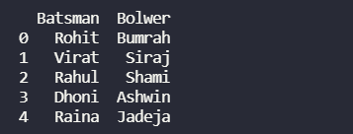
read_table()
We can read data from a text file using read_table() in pandas. This function reads a general delimited file to a DataFrame object. This function is essentially the same as the read_csv() function but with the delimiter = ‘\t’, instead of a comma by default. We will read data with the read_table function making separator equal to a single space(‘ ‘).
data=pandas.read_table('filename.txt', delimiter = ' ')
import pandas as pd
# read text file into pandas DataFrame
df = pd.read_table("gfg.txt", delimiter=" ")
# display DataFrame
print(df)

